Slide 1


Advancing Maternal and Fetal Health
Policy and STANDARDS
Point-of-Care Ultrasound (POCUS) Training and Certification
Pamela Ruiz
Chief Business Development Officer
Inteleos

Slide 2



The Global Leader in Certification: INTELEOS
MISSION
Inteleos Fuels the Global Health Community to Ensure Equitable Access to Quality Care.
45+ Years
130+ Countries
140,000+
Certified People
1,500,000+
Patients Cared
for Each Day
18 Medical Certifications in 31 Specialties
500+
Global Experts
90+ Staff
Inteleos is a non-profit certification organization that delivers rigorous assessments and cultivates a global community of medical professionals dedicated to the highest standards in healthcare and patient safety.

Slide 3


Better health for all in a changing world
OUTCOME OF PROCEEDINGS From: General Secretariat of the Council: 29 January 2024
“Strengthen health systems and advance universal health coverage – to improve equitable access to quality, accessible, acceptable and available health services including sexual and reproductive health care services – with a focus on primary healthcare, community participation and engagement, essential public health functions, research and digitalisation, a skilled and sufficient health workforce” ¹

Slide 4
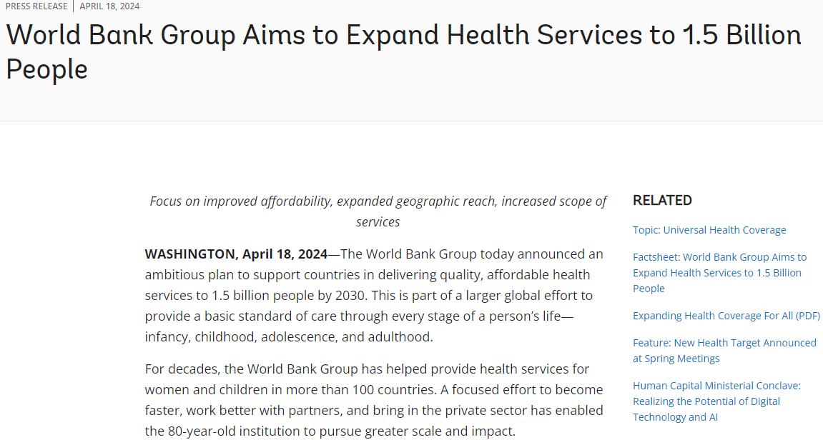

Slide 5

UN Strategic Development Goal 3: “Good Health and Well Being”
3.1: “By 2030, reduce the global maternal mortality ratio to less than 70 per 100,000 live births.”

Slide 6

Problem #1

Slide 7
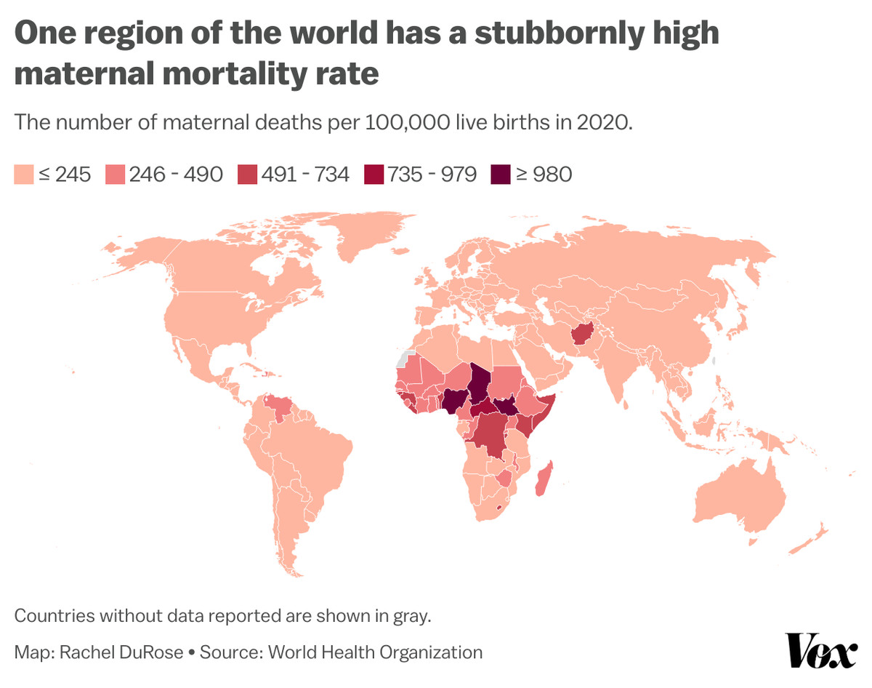
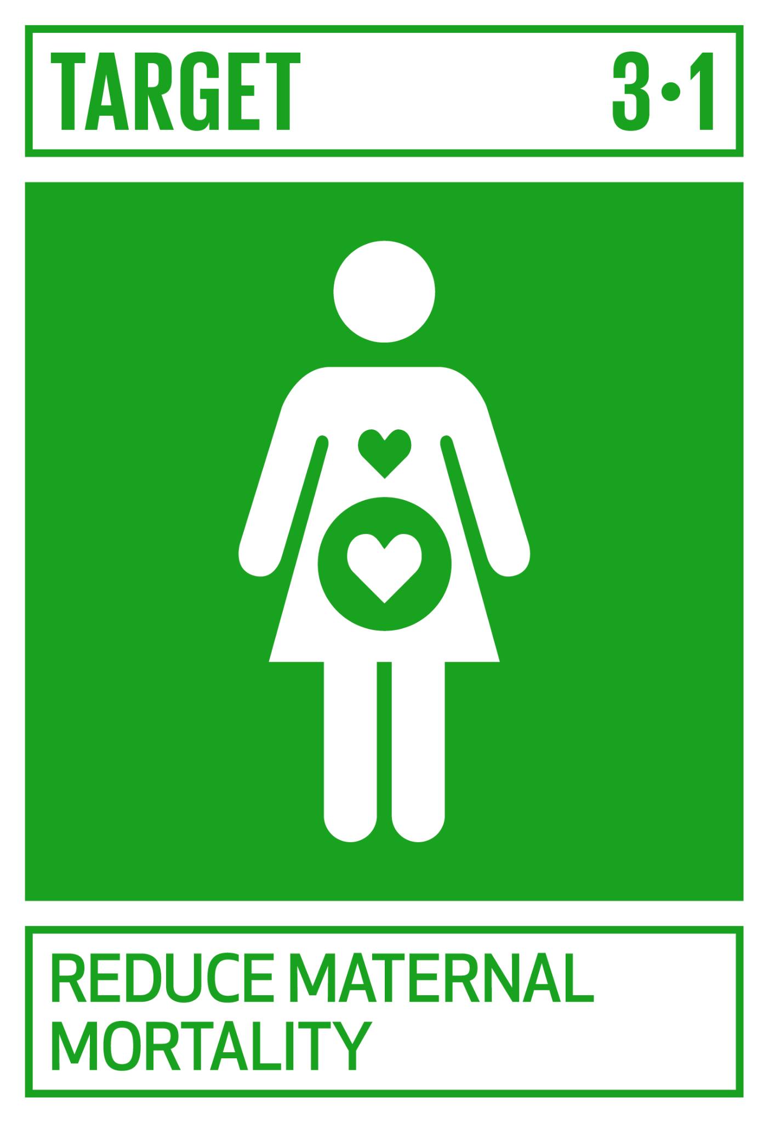
Maternal mortality in SSA remains stubbornly high
Source: WHO

Slide 8
Sub-Saharan Data: Maternal Mortality (2017)
Kenya: 50.22 million population, 25.27 million women
  342 women died per 100,000 births
  5,000 maternal deaths = .02% of female population
South Africa: 57.52 million population, 28.9 million women
  119 women died per 100,000 births
  1400 maternal deaths = .004% of female population
Nigeria: 190.9 million population, 94.19 million women
  917 women died per 100,000 live births – nearly 1%.
  67,000 maternal deaths = .07% of total female population
  Nigeria accounts for 20% of all maternal deaths globally
Many of these deaths are preventable.
https://data.worldbank.org/indicator/SH.STA.MMRT?locations=KE
https://data.worldbank.org/indicator/SH.STA.MMRT?locations=ZA
https://data.worldbank.org/indicator/SH.STA.MMRT?locations=NG
https://www.who.int/news-room/fact-sheets/detail/maternal-mortality

Slide 9

A Closer look
1 in 37 women in Africa have a likelihood of dying of pregnancy-related causes²
Hemorrhage accounts for 27% of maternal deaths³ with 85% of post-partum hemorrhage (PPH) in SSA and Southeast Asia⁴
Many risk factors can be managed if there is quality antenatal care that includes ultrasound⁴

Slide 10
Three Delays in Care
Deciding to seek appropriate medical help for an obstetric emergency
1
Reaching an appropriate obstetric facility
2
Receiving adequate care when a facility is reached
3
*https://pubmed.ncbi.nlm.nih.gov/9579750/#:~:text=The%20%22Three%20Delays%22%20model%20proposes,when%20a%20facility%20is%20reached

Slide 11

Problem #2
The ability to implement tangible, sustainable and scalable solutions to Problem #1 at a national and global scale

Slide 12

Address #3: “Receiving adequate care when a facility is reached”
63% of the Kenyan population is within one hour of a health facility⁵
Most Kenyan healthcare facilities have at least one nurse or midwife⁶ and most antenatal care is provided by midwives and nurses⁷

Slide 13

All women must have access to quality healthcare at the point of care
Midwives, nurses, and primary clinicians that stay within scope of OB ultrasound as part of “the referral chain…with structured and certified levels of competencies”⁸ can reduce wait times
Primary clinicians across LMICs can be certified to scan and document:
  Fetal lie and presentation
  Detection of fetal cardiac activity
  Number of fetuses in the uterus
  Location and position of the placenta
  Amniotic fluid volume

Slide 14
Access to quality care
At the hands of a proficient clinician, ultrasound leads to life-saving interventions in up to 48% of women⁹
In a study from Liberia, ultrasound changed patient management in 62% of cases¹⁰

Slide 15
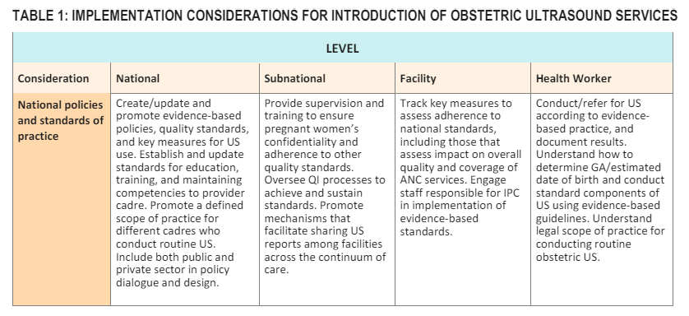
IMAGING ULTRASOUND BEFORE 24 WEEKS OF PREGNANCY¹¹
2022 update to the WHO antenatal care recommendations
“Policymakers at national and local levels should promote evidence-based standards for health workers”

Slide 16
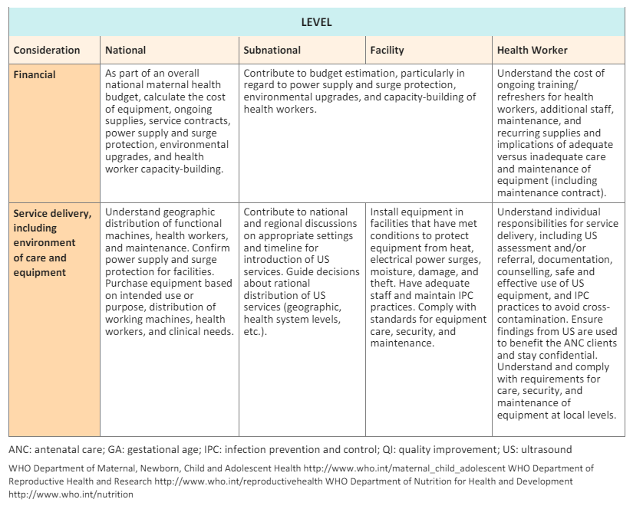
WHO
IMAGING ULTRASOUND BEFORE
24 WEEKS OF PREGNANCY¹¹
“Countries should adopt a standardised curriculum and competency assessment for teaching health workers”¹¹

Slide 17
A global standard of proficiency for POCUS through Certification
Point-of-care ultrasound has been used in Sub Sahara for 10-15 years but not uniformly
Many different trainings and research studies by universities and device manufacturers for OB POCUS, but no cohesive effort or standard
Research states that in LMICs “there is a need for an internationally recognized standard of training or a certificate program”¹² and that “professional organizations and inter-governmental organizations should…create standard curricula and…certification in basic ultrasound for clinicians”¹³

Slide 18
A standard policy framework
Certification
University curriculum
On the job training
Research cohorts
Standard
Quality

Slide 19
infrastructure and standards are needed
“There is a need to incorporate obstetric ultrasound training in both the undergraduate and postgraduate curricula of midwifery training in African countries. In-service training must be done for the midwives that are already in practice to expedite the task shifting and extension of scope of practice regarding obstetric ultrasound training to midwives as they are the first contact and primary caregivers for pregnant women across all levels of care in African countries.”¹⁴
Sanele Lukhele
Lecturer at University of the Western Cape; Midwife, Maternal and Child Health Specialist

Slide 20

Case study: Kenya
Stakeholder engagement, consensus and implementation – Public and Private
Baseline canvas survey with Ministry of Health
Ministry of Health: Creation and implementation of scope of practice, policies and procedures with subject matter experts
Universities: Inclusion in curriculum, certification assessment at end of studies
Health systems with ultrasound proficient primary clinicians at every level and county
Initial funding (USAID), sustainable financial models may include:
  Global and national government subsidies towards workforce development and Universal Health Coverage (UFC)
  Fee-based, building local economies
  Bundled and subsidized by device manufactures

Slide 21
Certification as a global standard
“A standard provides a framework for ensuring quality, transparency, and interoperability. The international standard ISO/IEC 17024, Conformity assessment — General requirements for bodies operating certification of persons, provides a global benchmark for quality certification.
During recent years, this standard — developed by the International Organization for Standardization (ISO), Online 12 International Journal of HRD Practice Policy, and Research which represents members from 162 countries — has fundamentally altered the delivery of certifications and created a very strong drive to globalize personnel certification.”¹⁵
Vijay Krishna, Ph.D
Consultant, International Organization for Standardization (ISO)
Vice President, Credentialing, ANSI National Accreditation Board/ANAB

Slide 22
Call to action
Certification enables a sustainable common language and standard within healthcare that cuts across hospital systems and national borders
Through global standards and certification as policy, access to quality care rises for all
Global and national government subsidies towards workforce development and Universal Health Coverage (UFC) will strengthen health systems
Ultrasound at the point of care is clinically sound and cost-effective¹⁶ but capacity-building, policy and scaling needs global support

Slide 23

Thank you
www.Inteleos.org
Pamela.ruiz@inteleos.org
https://www.linkedin.com/in/pamelamruiz/

Slide 24
References
https://data.consilium.europa.eu/doc/document/ST-5908-2024-INIT/en/pdf#:~:text=The%20Council%20acknowledges%20that%20the,societies%2C%20including%20within%20the%20EU
https://www.globalcitizen.org/en/content/maternal-mortality-sub-saharan-africa-causes/
https://www.who.int/news/item/14-08-2023-who-announces-the-first-meeting-of-the-postpartum-haemorrhage-(pph)-bundle-guideline-development-subgroup#:~:text=Obstetric%20haemorrhage%20is%20the%20leading,to%20postpartum%20haemorrhage%20(PPH).
https://www.un.org/africarenewal/magazine/october-2023/who-issues-plan-tackle-leading-cause-death-childbirth#:~:text=Over%2085%25%20of%20deaths%20from,as%20infections%20and%20pre%2Declampsia.
Noor AM, Amin AA, Gething PW, Atkinson PM, Hay SI, Snow RW. Modelling distances travelled to government health services in Kenya. Trop Med Int Health. 2006 Feb;11(2):188-96. doi: 10.1111/j.1365-3156.2005.01555.x. PMID: 16451343; PMCID: PMC2912494.
https://dhsprogram.com/pubs/pdf/spa8/02chapter2.pdf
Bidner, A., Bezak, E., & Parange, N. (2022). Evaluation of antenatal Point-of-Care Ultrasound (PoCUS) training: a systematic review. Medical Education Online, 27(1). https://doi.org/10.1080/10872981.2022.2041366
Wanyonyi SZ, Mariara CM, Vinayak S, Stones W. Opportunities and Challenges in Realizing Universal Access to Obstetric Ultrasound in Sub-Saharan Africa. Ultrasound Int Open. 2017 Apr;3(2):E52-E59. doi: 10.1055/s-0043-103948. Epub 2017 Jun 7. PMID: 28596999; PMCID: PMC5462610.

Slide 25
References (cont.)
Okong P, Byamugisha J, Mirembe F, Byaruhanga R, Bergstrom S. Audit of severe maternal morbidity in Uganda--implications for quality of obstetric care. Acta Obstet Gynecol Scand. 2006;85(7):797-804. doi: 10.1080/00016340600593331. PMID: 16817076.
Kotlyar, Simon1,; Moore, Christopher L1. Assessing the utility of ultrasound in Liberia. Journal of Emergencies, Trauma and Shock 1(1):p 10-14, Jan–Jun 2008. | DOI: 10.4103/0974-2700.41785
https://iris.who.int/bitstream/handle/10665/362037/9789240051461-eng.pdf?sequence=1
Kim, E.T., Singh, K., Moran, A. et al. Obstetric ultrasound use in low and middle income countries: a narrative review. Reprod Health 15, 129 (2018). https://doi.org/10.1186/s12978-018-0571-y
Sippel, S., Muruganandan, K., Levine, A. et al. Review article: Use of ultrasound in the developing world. Int J Emerg Med 4, 72 (2011). https://doi.org/10.1186/1865-1380-4-72
Lukhele S, Mulaudzi FM, Sepeng N, Netshisaulu K, Ngunyulu RN, Musie M, Anokwuru R. The training of midwives to perform obstetric ultrasound scan in Africa for task shifting and extension of scope of practice: a scoping review. BMC Med Educ. 2023 Oct 12;23(1):764. doi: 10.1186/s12909-023-04647-w. PMID: 37828497; PMCID: PMC10571413.
Krishna, V. (2019). Developing a Competency-Based Credentialing Framework for National Human Resource Development. International Journal of HRD Practice, Policy and Research, 4(1). doi: 10.22324/ijhrdppr.4.102
Bussmann, H., Koen, E., Arhin-Tenkorang, D., Munyadzwe, G. and Troeger, J. (2001), Feasibility of an ultrasound service on district health care level in Botswana. Tropical Medicine & International Health, 6: 1023-1031. https://doi.org/10.1046/j.1365-3156.2001.00807.x

